Slide 1
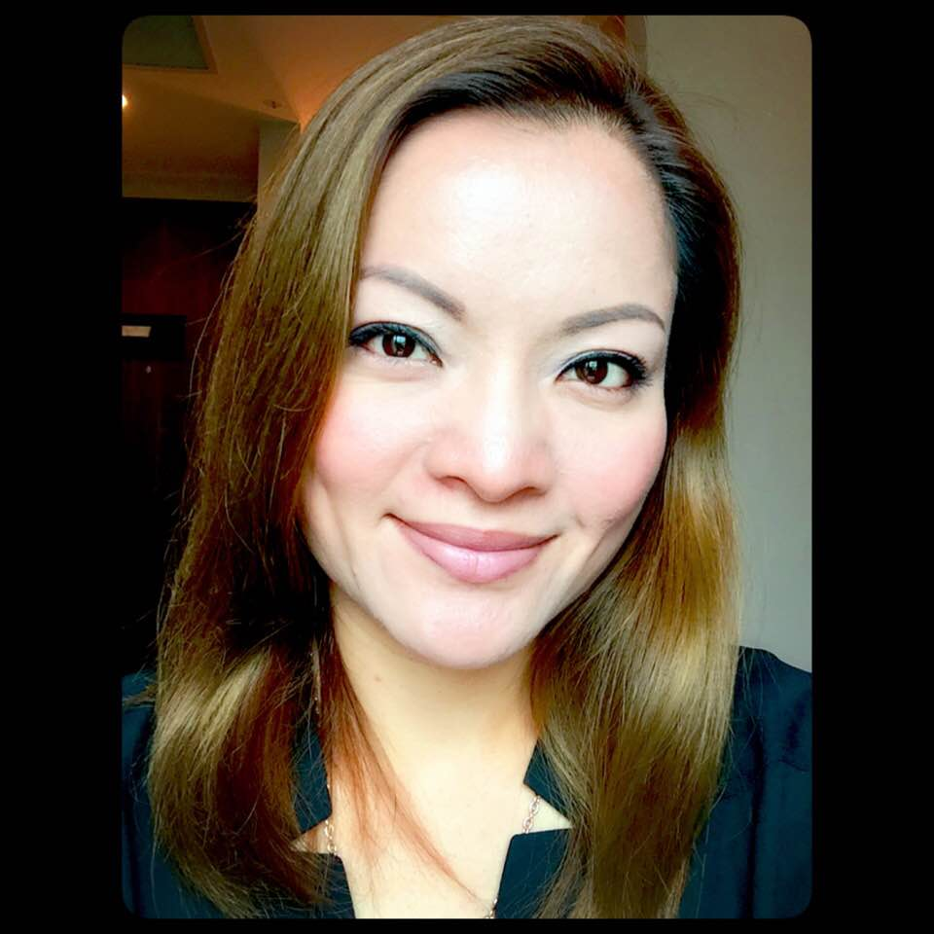
開創超連鎖事業新思維 Open your mindset for UnFranchise Business
Lilian Chan
顧問經理級 Supervising Coordinator
四個佣金週期共賺取HK$57,500
HK$57,500 in 4 Commission weeks
本簡報中提到的收入等級純屬舉例說明，無意代表美安香港超連鎖店主的一般收入，也無意表示任何超連鎖店主皆可賺取同等收入。美安香港超連鎖店主的成功與否，取決於其在發展事業時的努力、才能與投入程度。The income levels mentioned in the following presentation are for illustration purposes only. They are not intended to represent the income of a typical Market Hong Kong UnFranchise Owner, nor are they intended to represent that any given Independent UnFranchise Owner will earn income in that amount. The success of any Market Hong Kong Independent UnFranchise Owner will depend upon the amount of hard work, talent, and dedication which he or she devotes to building his or her Market Hong Kong Business.

Slide 2
開創超連鎖事業新思維 Open your mindset for UnFranchise Business
打工一族
從事市場推廣工作十年
2008年 9月加盟美安香港
現為顧問經理超連銷店主
Had worked in the marketing field
for 10 years Joined mhk in 2008 September Now: Supervising Coordinator

Slide 5
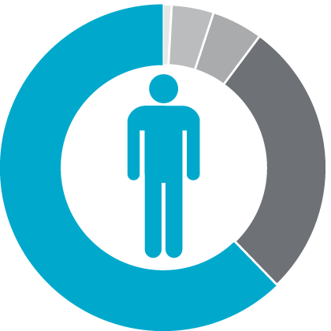
在年滿65歲的每100個人中…For every 100 people who should have reached the age of 65...
4%財務穩健Financially Fit
1%富有Wealthy
5%仍在工作Still Working
95%
62%貧窮／身無分文
Struggling Financially
28%已逝世Dead

Slide 6
The world's best business opportunity

Slide 7
如何成為企業家

Slide 8
「靶心概念」Target Concept
由外及内，
逐漸深入！
From the outside in,
Step by step
新超連鎖店主訓練NUOT
成功五要訣訓練 B5
授證經理級訓練ECCT
一對一介紹 One on Ones
超連鎖事業簡報會 UnFranchise Business Presentations
本地研討會 L o c a l S e m i n a r s
美安香港年會 Market Hong Kong Convention
領袖訓練會議 Leadership
世界大會 World Conference
國際年會
Int'l Convention
你的目標應該是帶領更多「積極進取型」(Go Now)超連鎖店主參加下一次國際年會…但是一切要從外環做起…
三對一介紹，二對一介紹，一對一介紹
Your goal is to bring more “Go Now” UFOs to the next International Convention….but start from the outside, 3 to 1, 2 to 1 and 1 to 1 presentations.
Notes:
8
8

Slide 9
美安超連鎖TM系統的核心 --- 複製 推薦適當人選成為獨立超連鎖TM店主。
The core of UnFranchiseTM System – Duplication
Recruit suitable ones to be UnFranchiseTM Owner.

Slide 11
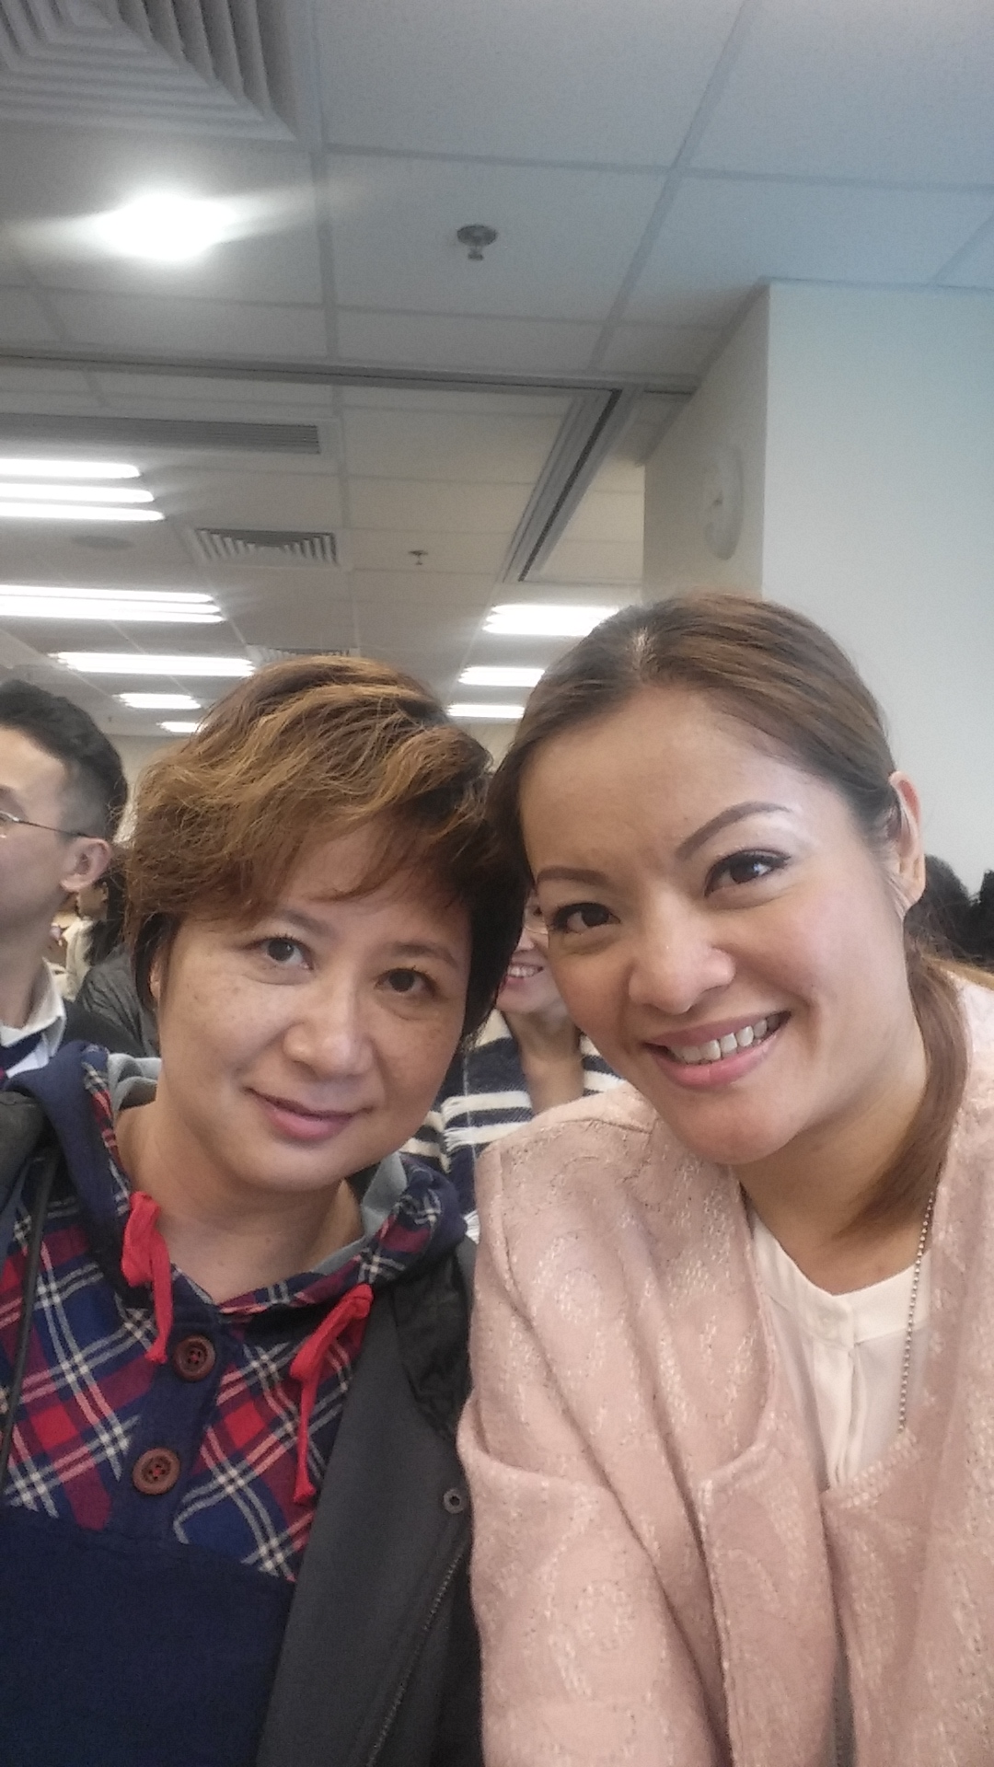
好夥伴
Good Partner

Slide 12
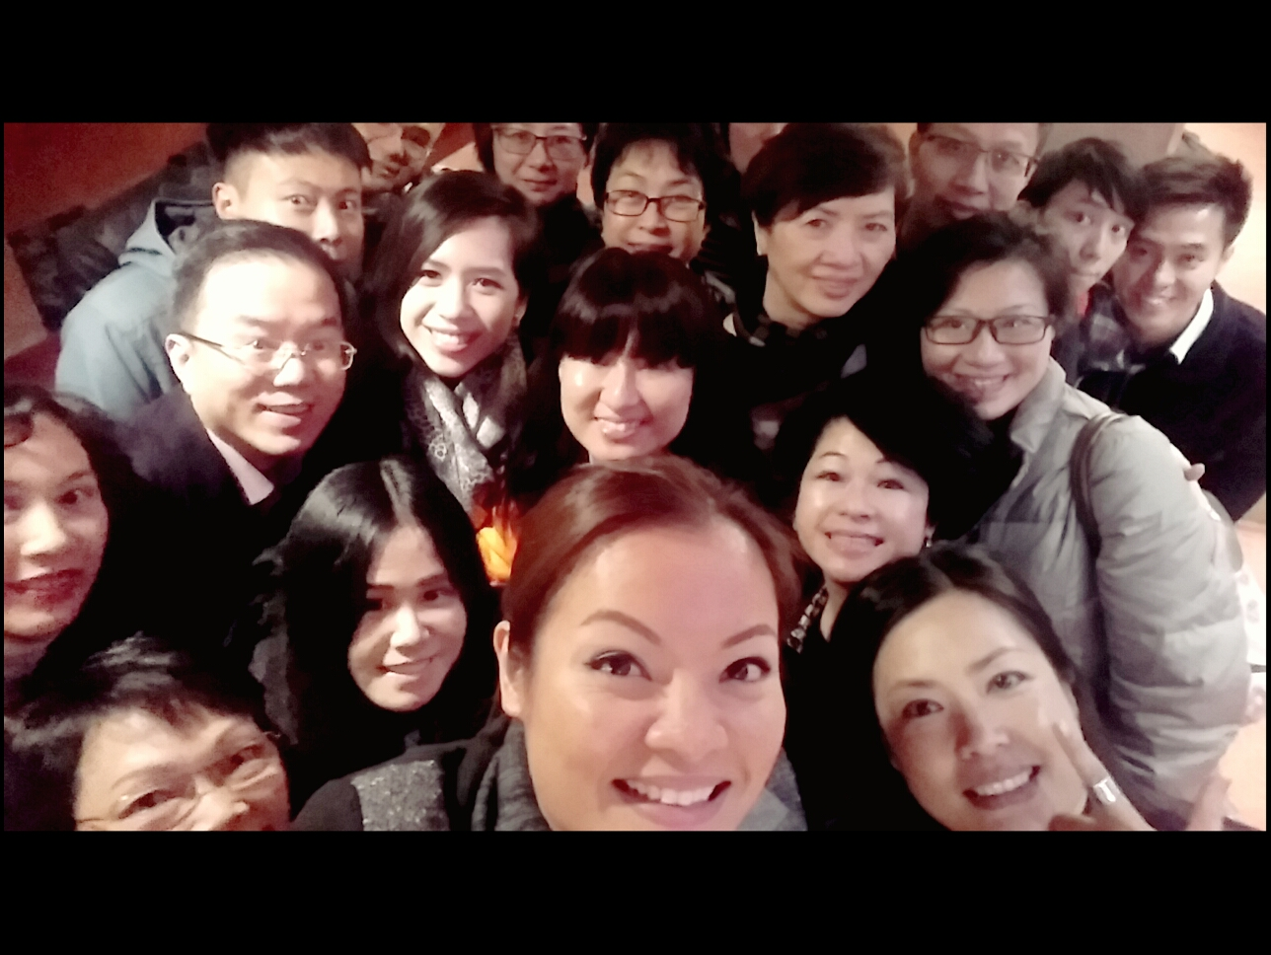
與團隊
合作
Work
as a team.

Slide 13
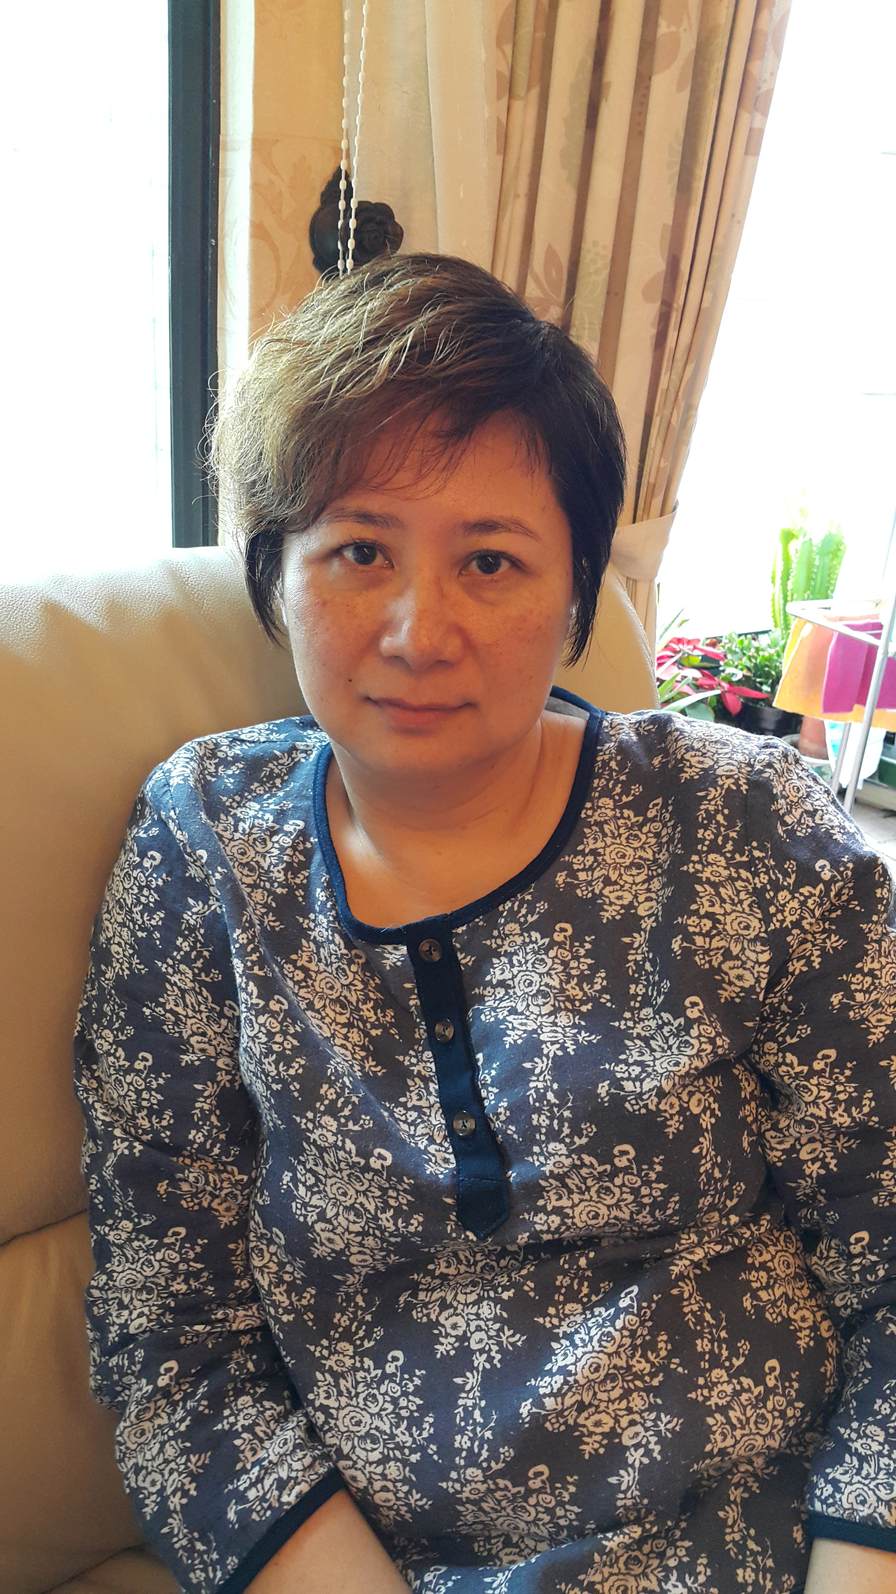
Janis Lee
教育工作二十多年
教師培訓
2014年4月8日加盟美安
Had worked in Education field
for more than 20 years Teacher training Joined mhk in April 8, 2014

Slide 14
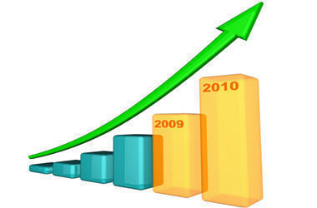

Slide 16
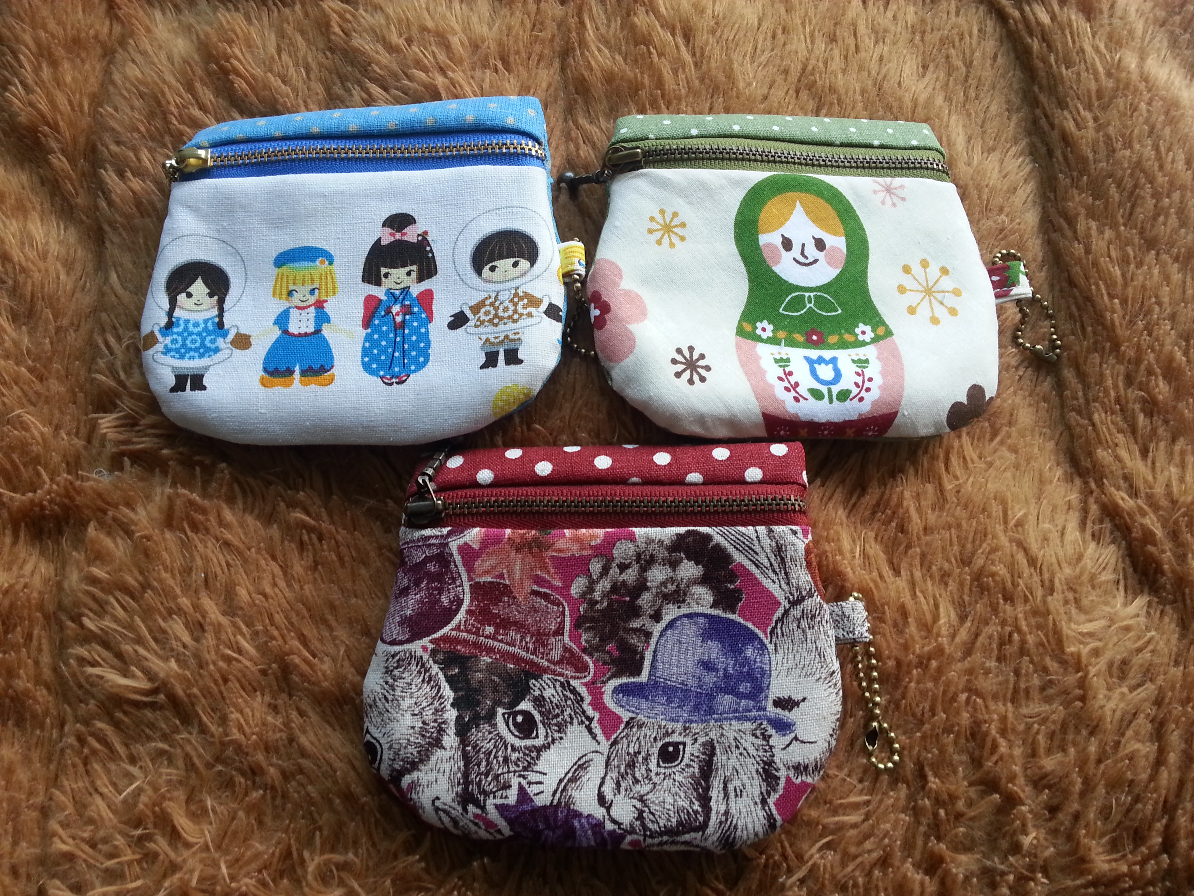
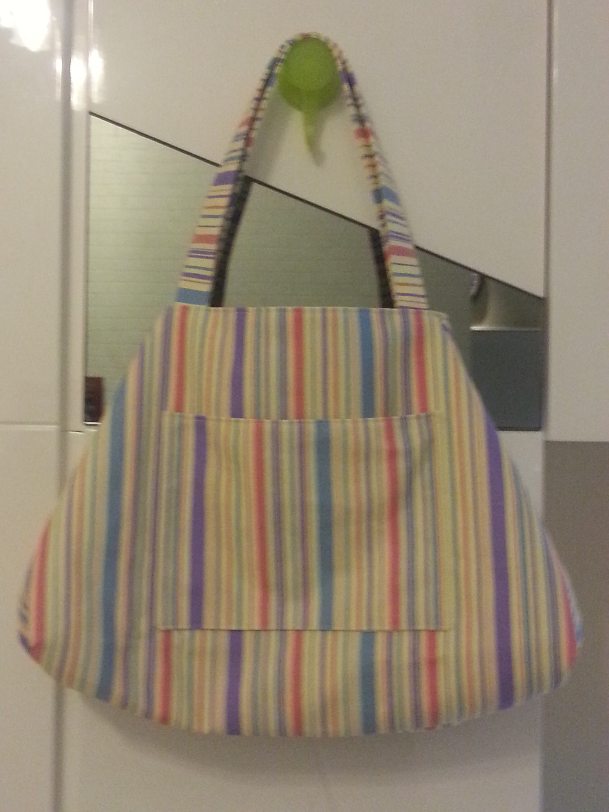
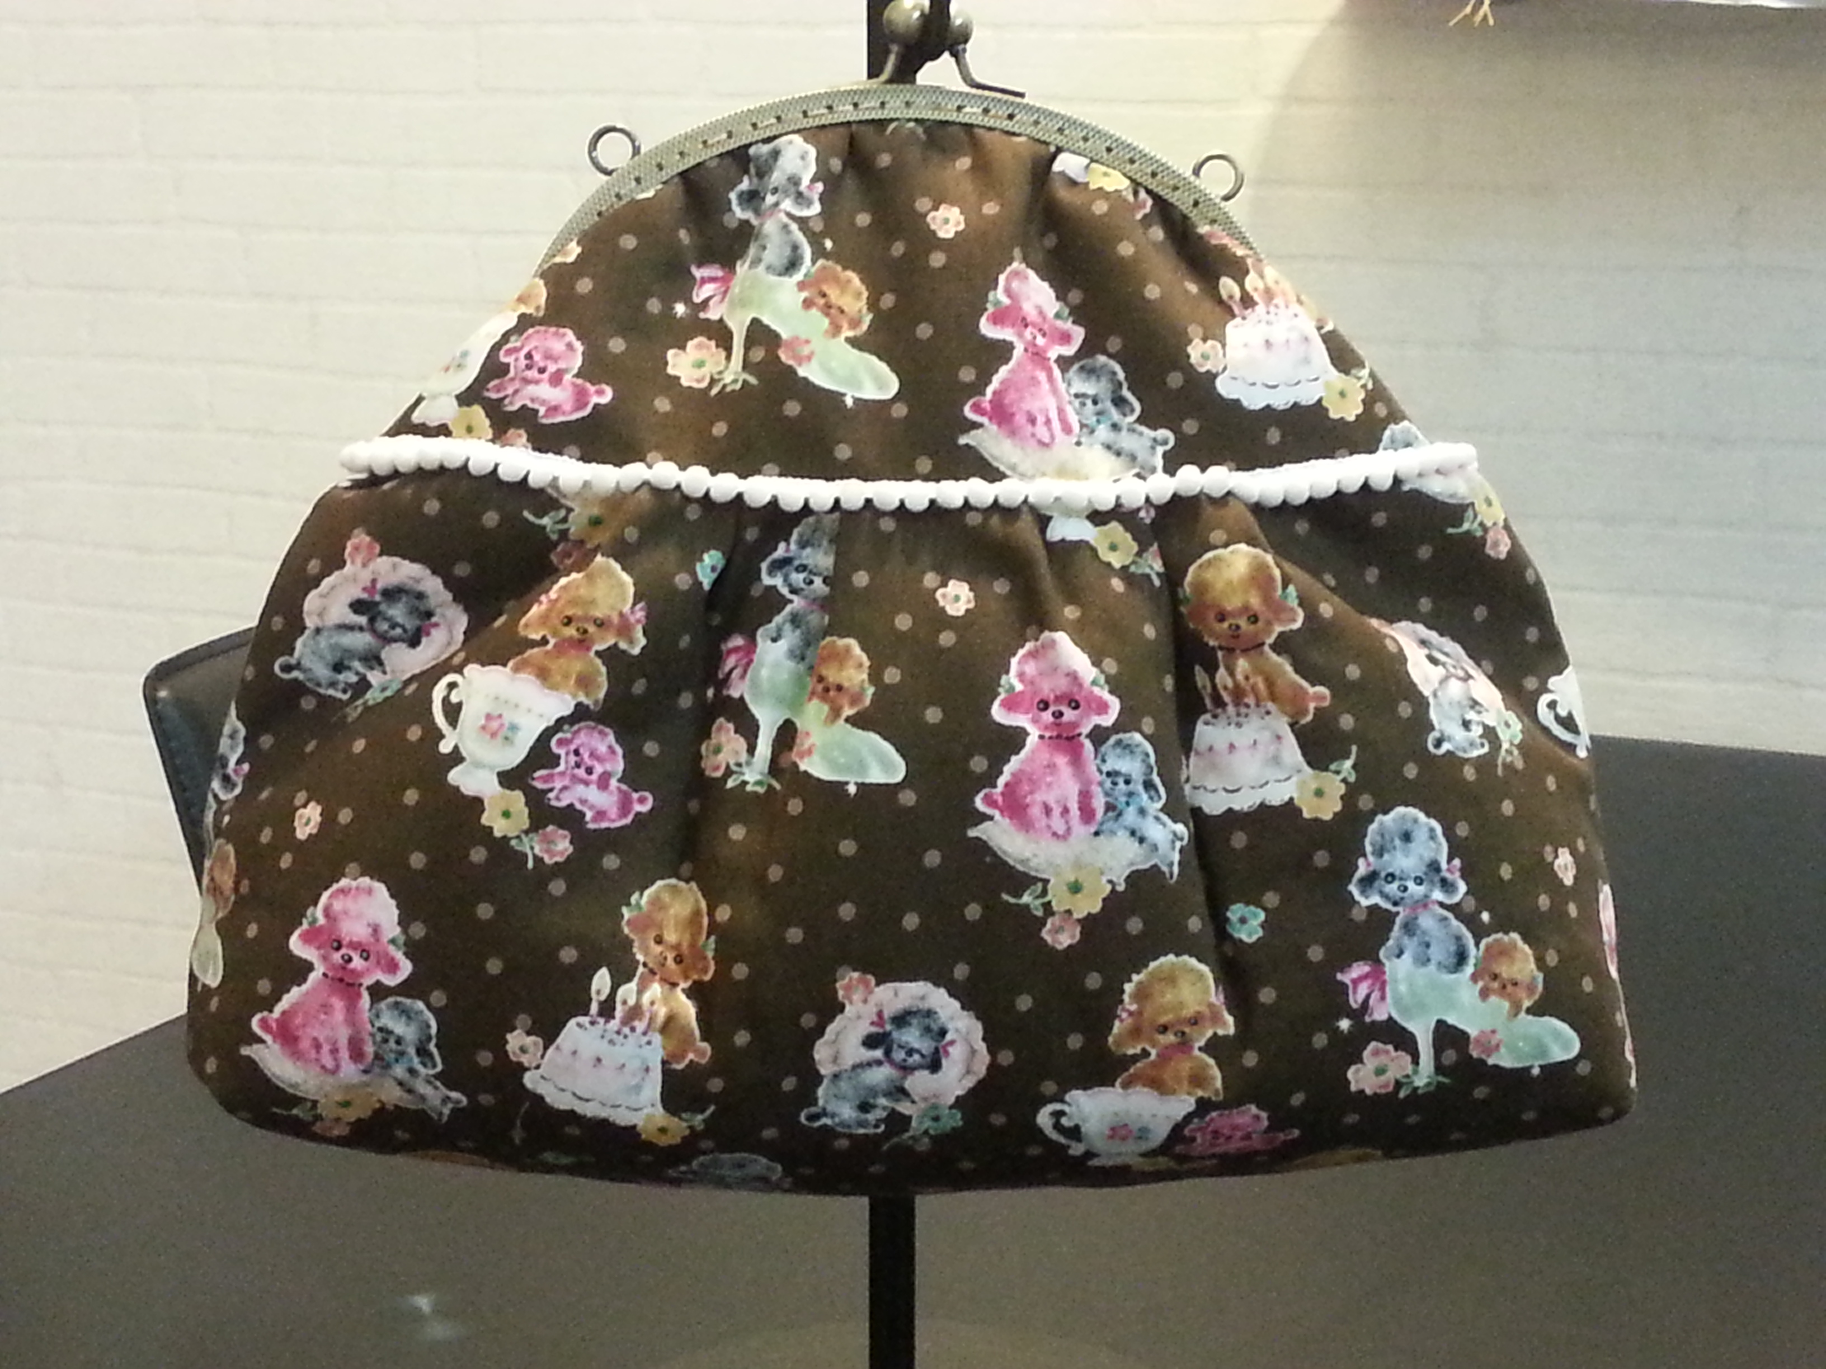

Slide 18
香港大會
HK conventions
Coring
NUOT
B5
ECCT
本地研討會 Local Seminar
產品訓練 Product Training

Slide 19
台灣 Taiwan
美國USA
新加坡 Singapore

Slide 20
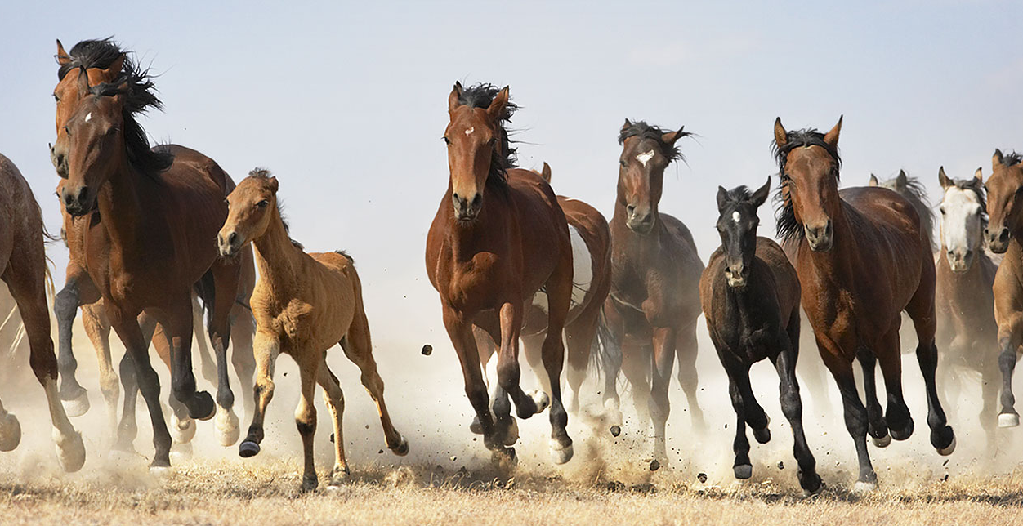
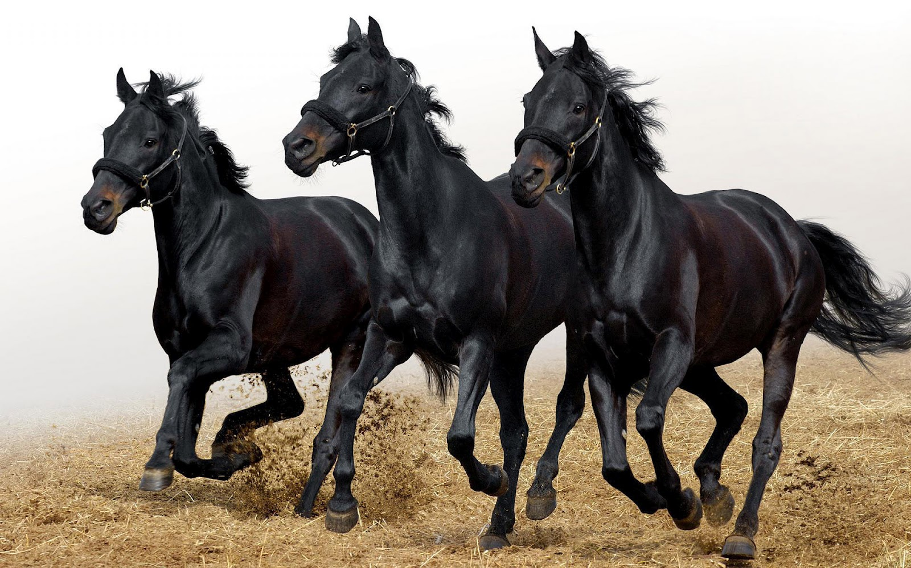

Slide 21
美國大會嘉許環節 Recognition at MA conventions

Slide 22
你的Your
舊Old
腦袋Brain

Slide 24
蛻變Transformation

Slide 25
2008. 09 加盟美安 Joined mhk
2008-NOW 香港、台灣、美國大會HK,TW,US events
2013. 11 晉升主管經理 MC
2013. 12 全職美安 Full-time UFO
2014. 02 晉升資深主管經理 SMC
2014. 06 晉升專業經理 PC
2014. 11 晉升顧問經理 SC
收入Income +130%

Slide 26
